Slide 1
Using Secondary Data And Online Information Databases Frank Lin

Slide 2




Classification of Data
Primary: information that is developed or gathered by the researcher specifically for the research project at hand
Secondary: information that has previously been gathered by someone other than the researcher and/or for some other purpose than the research project at hand

Slide 3
Uses of Secondary Data
Secondary data has many uses in marketing research. For example,
Economic-trend forecasting
Corporate intelligence
International data
Public opinion
Historical data
Visit 🡪 www.SecondaryData.com (recommended)

Slide 4
Classification of Secondary Data
Internal data: Data that has been collected within the firm. For example,
Sales records
Invoices
External data: Data that has been prepared and published for distribution. For example,
External database

Slide 5
Internal Data
Database: Refers to collection of information describing items of interest
Database:
Records Fields
Data mining

Slide 6
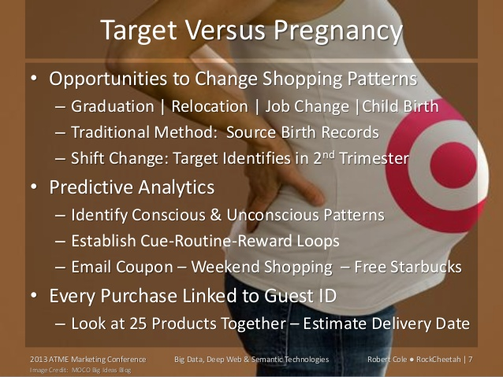
Notes:
Marketing analytics is the term often used to refer to the management and analysis of data to improve marketing decisions. Sources of data can originate from many places, including companies, sensors, retailers, trade organizations, governments, publishers, the Internet
and social media. These data take many forms, both qualitative and quantitative, including text, photos, videos, business transactions, research data, and many other types of data. There
is simply too much data available for any one company to exhaustively gather, store, analyze, and report. Decisions must be made about what data to collect and how to analyze the data
to find trends, patterns, and relationships among data from multiple sources. Effective use of multiple sources of data requires having the resources and talent available to retrieve, store,
integrate, analyze, report, and protect the data.

Slide 7
External Data
Publicly available: sources for public distribution. Normally found in libraries, trade organizations etc.
Syndicated Services data: provided by firms that collect data in a standard format and make them available to subscribing firms – highly specialized and not available in libraries. An example: Nielsen Scanner data
External databases: databases supplied by organizations outside the firm such as online information databases (e.g., FACTIVA and Lexis Nexis)

Slide 8
Advantages of Secondary Data
Are obtained quickly
Are inexpensive
Are usually available
Enhance existing primary data

Slide 9
Disadvantages of Secondary Data
Reporting units are incompatible
Measurement units do not match
Class definitions are not usable
Data are outdated

Slide 10
Evaluating Secondary Data
What was the purpose of the study?
Who collected the information?
What information was collected?
How was the information attained?
How consistent is the information with other information?

Slide 11
Key Sources of Secondary Data
Census of the Population (www.census.gov): considered the “granddaddy” of all market information
Conducted every ten years
Provides Demographic variables such as age, sex, occupation etc. at a zip code level

Slide 12
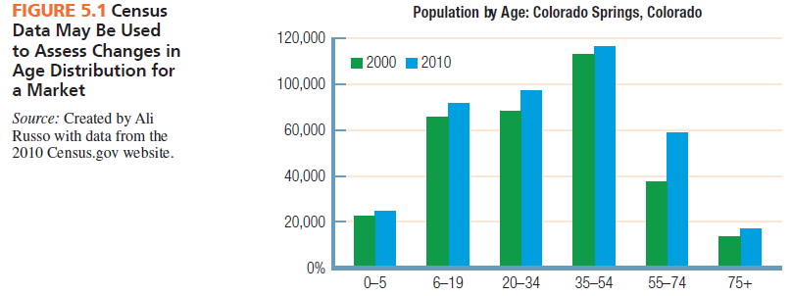

Slide 13
Social Media Data
User generated Content: information that is created by users of online systems and intended to be shared with others.
Types:
Reviews
Tips
New Uses
Competitor News
Sentiment Analysis
Word cloud

Slide 14
What’s next
PA3 due
CE4

